Slide 1
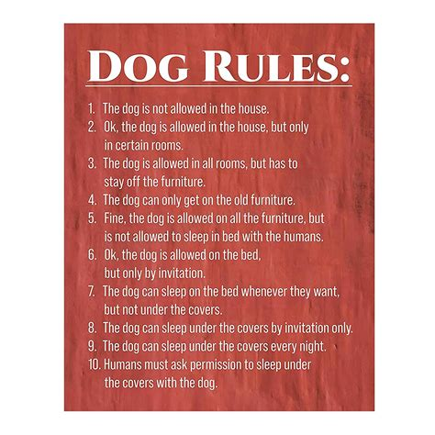
Do Now
Without getting out of your chair, quietly write in your notebook:
3 rules you have to follow at home
2 rules that are different at school
1 rule that is different in the community

Slide 2
Safety in the lab
Success Criteria
I can list the rules of the science lab
I can create a poster that shows how to follow a science lab rule

Slide 3
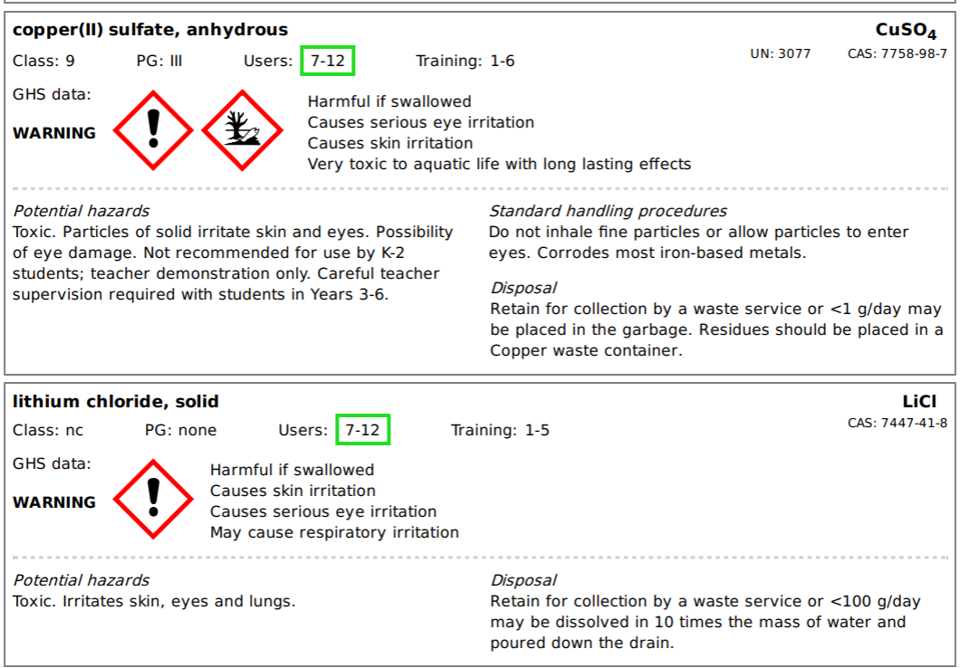
Why lab safety?
There are lots of dangerous things in these labs.
For example, you might burn yourself on a fire.
There are also some chemicals used that can make you very sick.

Slide 4

Notes:
https://www.youtube.com/watch?v=BRDApYgvDqQ&ab_channel=AsapSCIENCE if video doesn’t work

Slide 5
Lab Rules
Students will not perform unapproved experiments or use any equipment without prior instruction. Students will follow all of the instructions given by the teacher.
Students are not allowed in the supply room.
Students will wear eye protection when needed.
Students will clean messes appropriately before leaving the lab room.
Students will wear proper clothing during experiments. No open shoes and no dangling jewellery are allowed. Long hair should be tied back.
Students will not eat, drink, or chew gum in the lab.
Students will not take materials from the lab without teacher permission.
Students will not horseplay or play practical jokes.
Students will keep their lab area free from non-laboratory materials.
Students will immediately let the teacher know about accidents, spills, and injuries

Slide 6
Lab Rule #1
Students will not perform unapproved experiments or use any equipment without prior instruction. Students will follow all of the instructions given by the teacher.
We deal with dangerous objects and chemicals. I know what the risks are, you might not – something that seems safe could be dangerous if used in the wrong way.

Slide 7
Lab Rule #2
Students are not allowed in the supply room.
Lots of dangerous equipment. Anything could happen. There are active experiments in there, and the lab tech doesn’t have duty of care – she’s a technician, not a teacher.

Slide 8
Lab Rule #3
Students will wear eye protection when needed.
You saw the chemicals. They can cause blindness. Being blind isn’t fun.

Slide 9
Lab Rule #4
Students will clean messes appropriately before leaving the lab room.
Messes can lead to accidents. They can make it take longer to get to a space or out of a space. No, that small scrap of paper won’t be an issue, but if we think that about every scrap of paper, the mess will keep growing until it does become an issue – so let’s stop it early.

Slide 10
Lab Rule #5
Students will wear proper clothing during experiments. No open shoes and no dangling jewellery are allowed. Long hair should be tied back.
Closed shoes protect your feet from spills. Dangling jewellery can get caught in beakers and other equipment, as can hair. They can lead to things being knocked over, you getting stuck in a space when you need to evacuate.

Slide 11
Lab Rule #6
Students will not eat, drink, or chew gum in the lab.
These surfaces can’t always be cleaned thoroughly, and so residues from the chemicals can be left behind. In fact, your toilet is cleaner than the lab is! If you wouldn’t eat in your toilet, you shouldn’t eat in the lab.

Slide 12
Lab Rule #7
Students will not take materials from the lab without teacher permission.
If things need supervision in the lab, they definitely need supervision out of the lab. If I can’t be there, you can’t have the thing. And just because something looks safe, you don’t know what else it’s used for, where else it’s been, and what could be on its surfaces.

Slide 13
Lab Rule #8
Students will not horseplay or play practical jokes.
It’s all fun and games until someone gets hurt.

Slide 14
Lab Rule #9
Students will keep their lab area free from non-laboratory materials.
Imagine if those chemicals got on your things, into your bags, and on your food? Keep non-lab stuff away from lab stuff

Slide 15
Lab Rule #10
Students will immediately let the teacher know about accidents, spills, and injuries
You can probably clean this stuff up yourself, but if you get hurt, I get in trouble. If I get hurt, nobody cares. Let me get hurt, because then less people will worry. Particularly, chemical spills have specific clean-up procedures that I need to follow.

Slide 16
Science Safety Posters!
Task
Let’s try and make this room feel a bit more like “our” room.
You can work by yourself or in groups of 2-3, pick one of the rules and make a poster about it.
The best posters will be awarded 5 house points for everybody that worked on that poster!

Slide 17
Lab Rules
Students will not perform unapproved experiments or use any equipment without prior instruction. Students will follow all of the instructions given by the teacher.
Students are not allowed in the supply room.
Students will wear eye protection when needed.
Students will clean messes appropriately before leaving the lab room.
Students will wear proper clothing during experiments. No open shoes and no dangling jewellery are allowed. Long hair should be tied back.
Students will not eat, drink, or chew gum in the lab.
Students will not take materials from the lab without teacher permission.
Students will not horseplay or play practical jokes.
Students will keep their lab area free from non-laboratory materials.
Students will immediately let the teacher know about accidents, spills, and injuries

